Slide 1




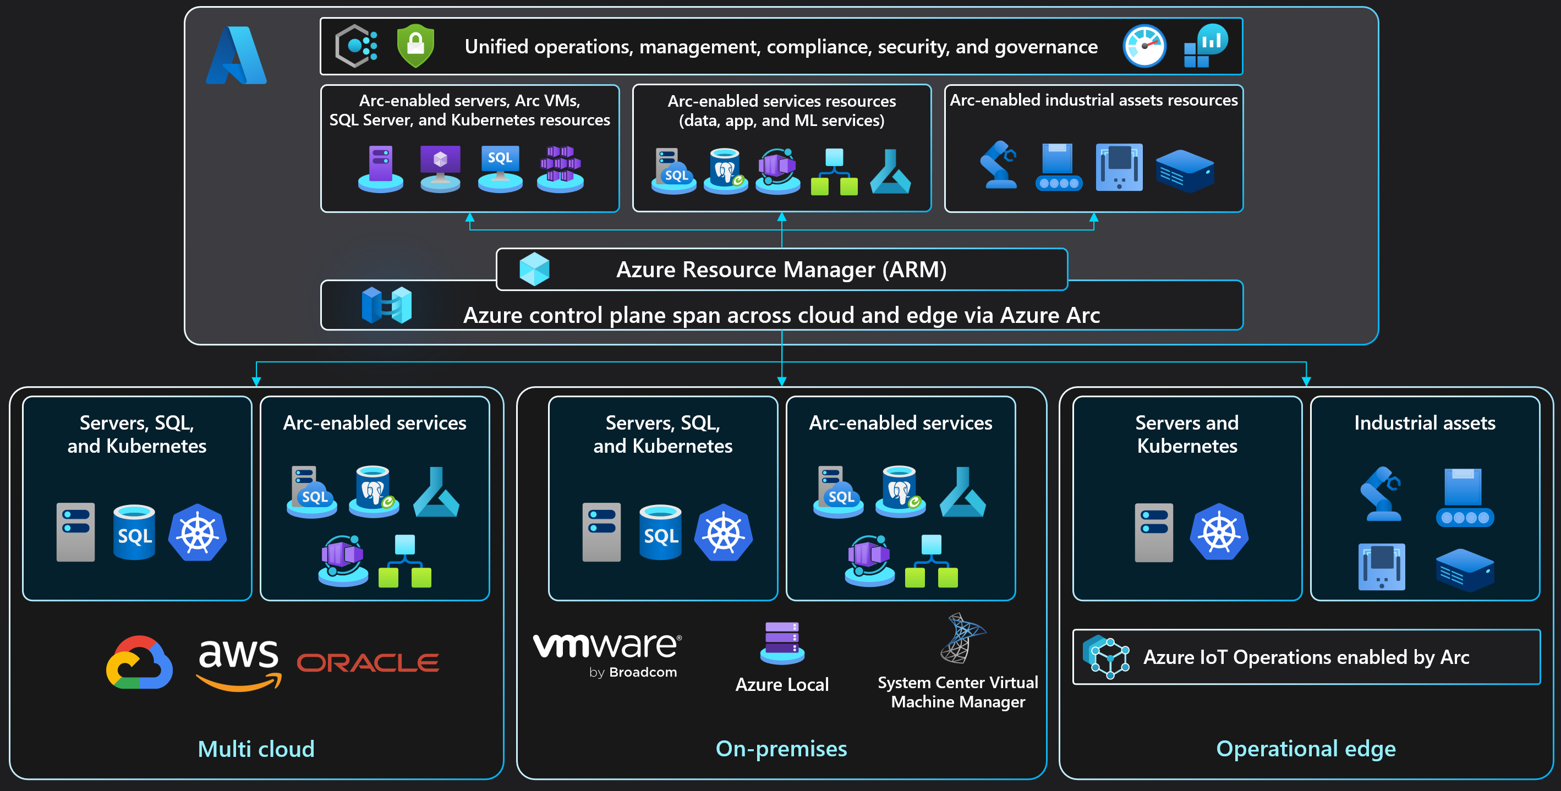
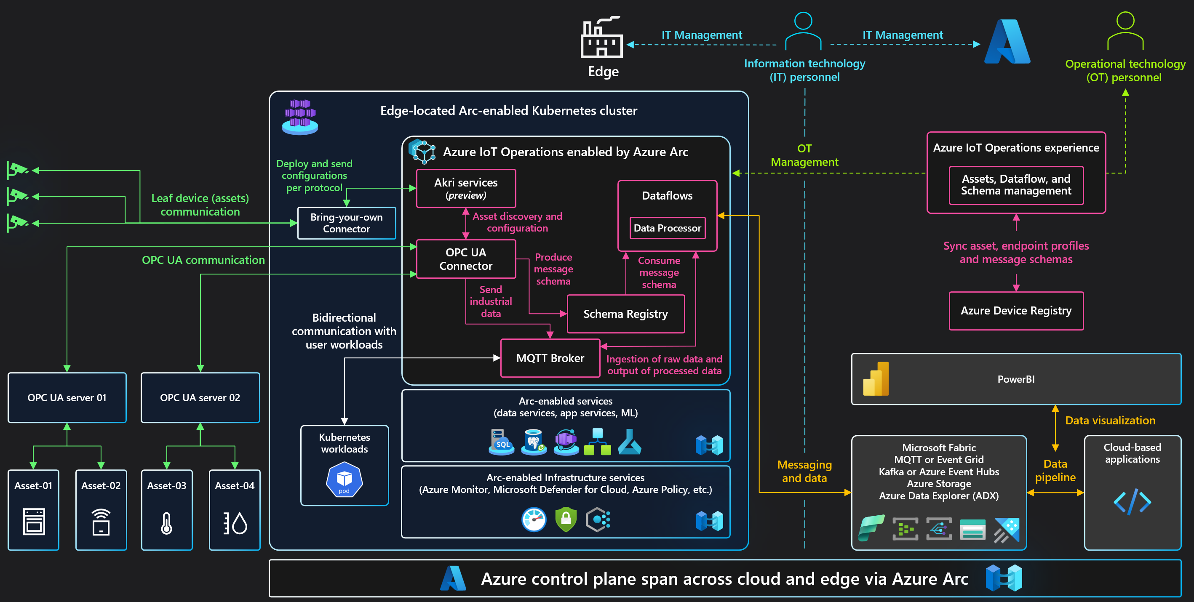
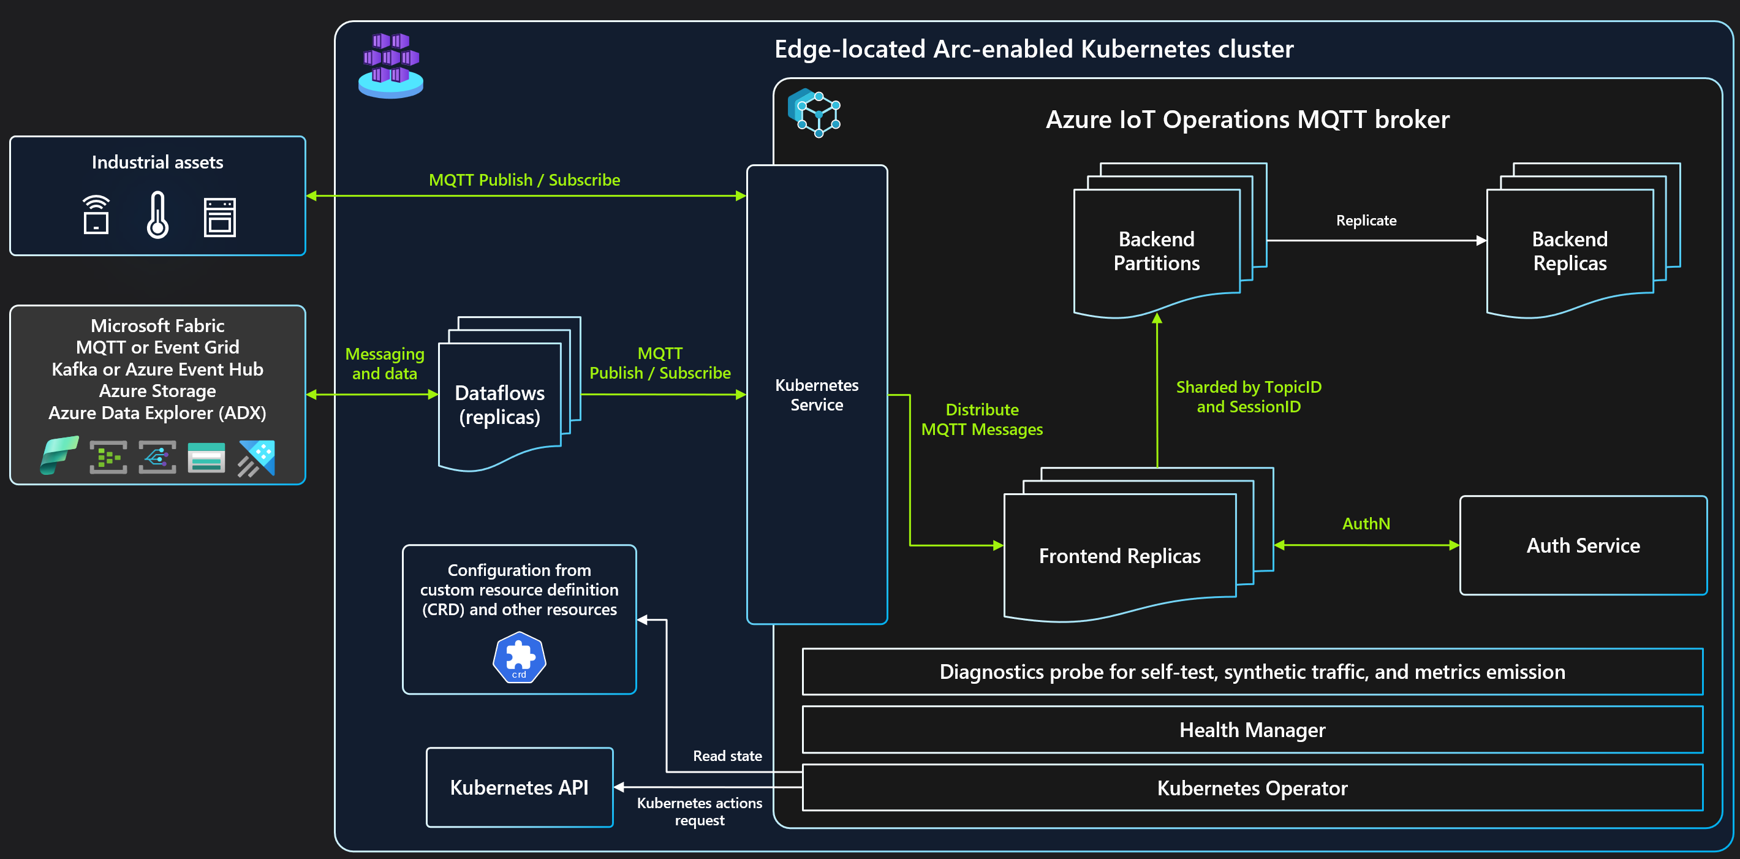
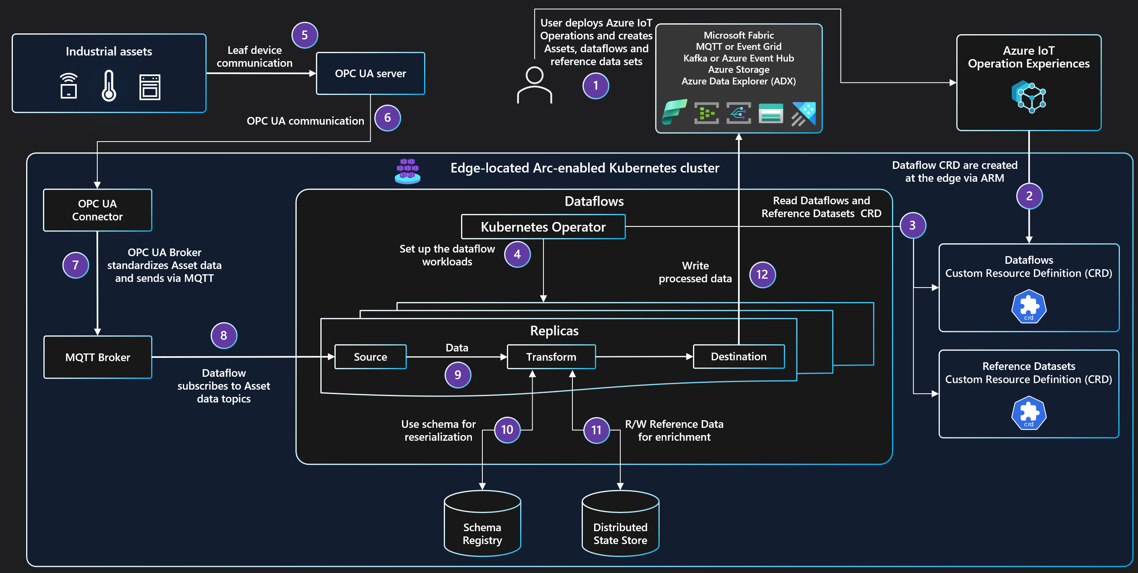
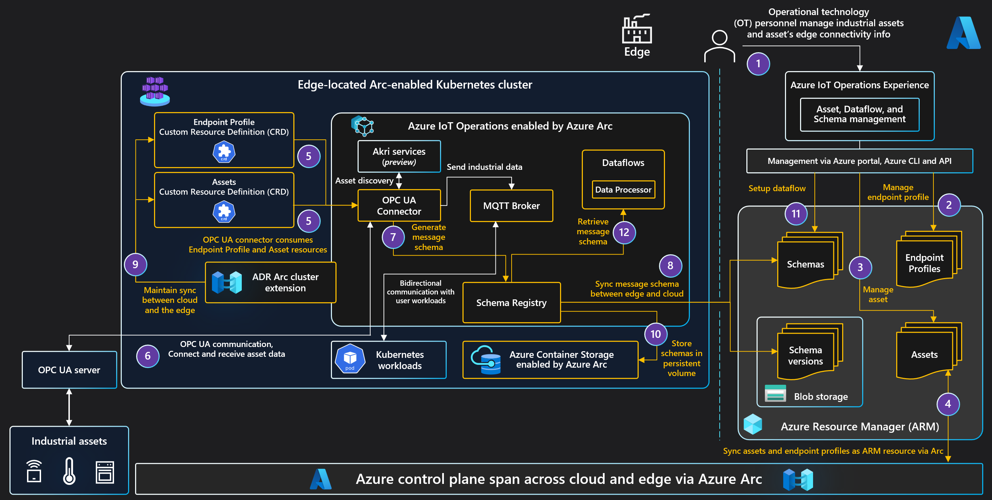
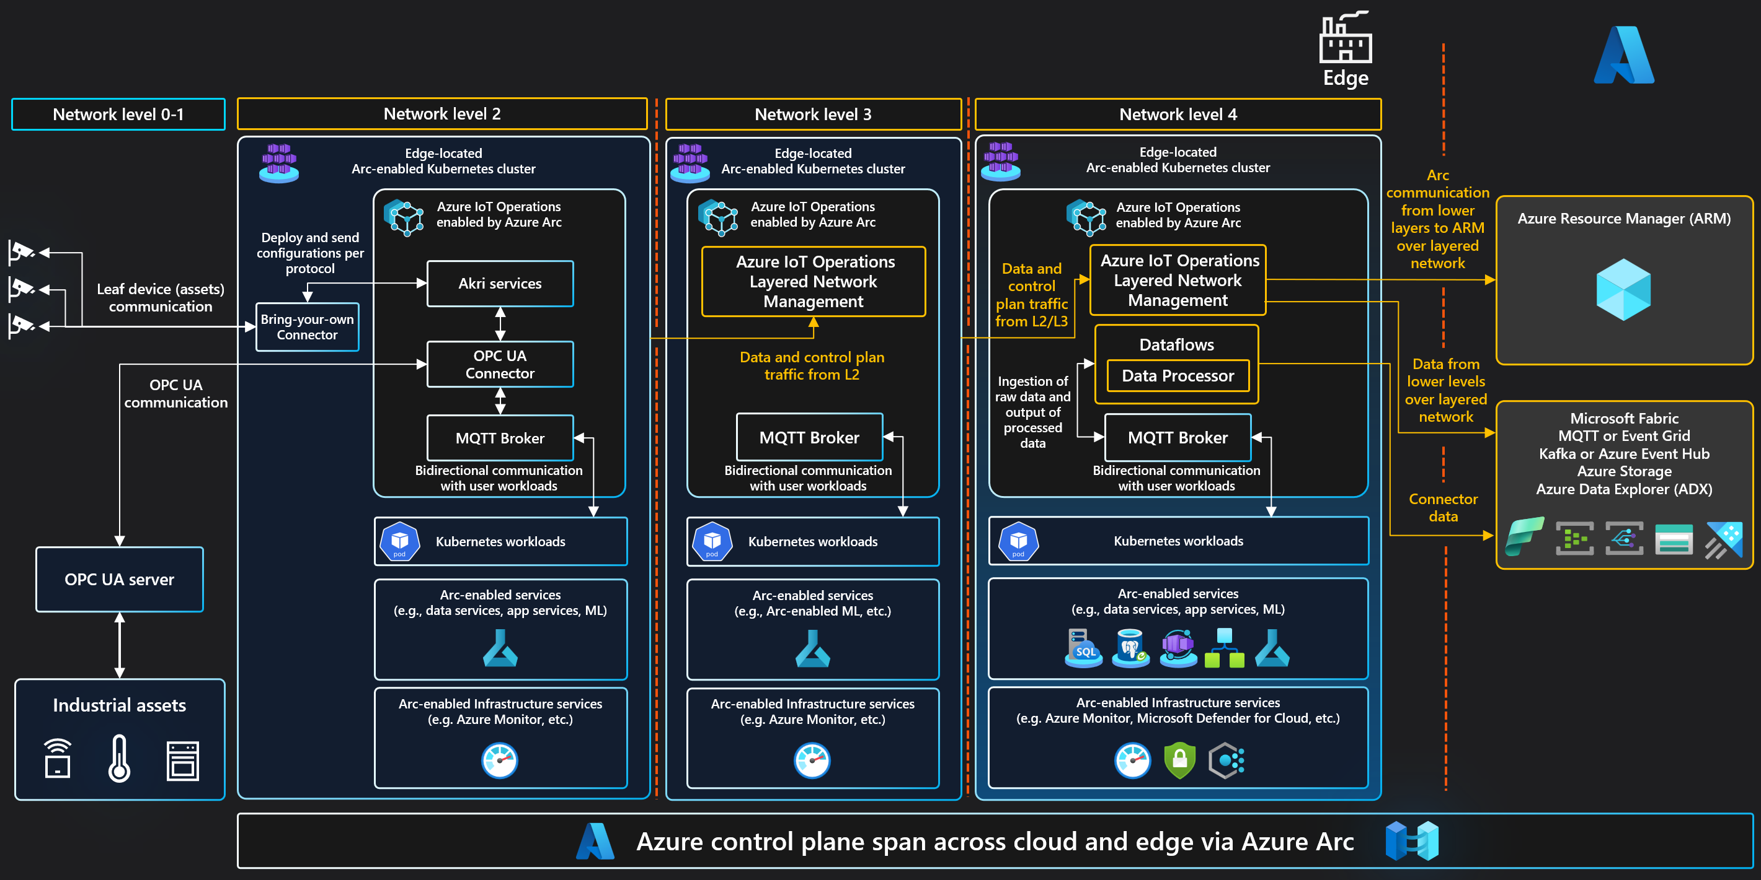

Azure IoT Operations enabled by Azure Arc
Azure Arc solution architecture
Solution overview
MQTT broker architecture
Dataflows MQTT based architecture
Azure Device Registry (ADR) architecture
Layered Network Management (LNM) architecture
Copyright @ 2025 Microsoft. All rights reserved. v1.5 #ArcJumpstart | aka.ms/JumpstartGems

